Slide 1

MACHINE LEARNING ACCELERATOR
Graph Machine Learning – Lecture 2
Notes:
Welcome to Machine Learning Accelerator – the Graph Machine Learning course
Week 2

Slide 2
Course Overview
Lecture 1
Lecture 2
Lecture 3
Day 2:
Intro to Graph Theory & Network Analysis
Intro to ML
ML Application on Real World Graphs
DGL at a Glance
Day 2:
Learning on Graphs
Deep Walk
Graph Neural Networks (GNNs)
Graph Convolution Networks (GCNs)
GCNs with DGL
Day 2:
Advanced GNN architectures
Learning on large graphs
Heterogenous Graphs
Case Study : Recommender System with GCNs
AMA

Slide 3
Traditional Methods
Learning on Graphs
Notes:
Before we introduce the concepts of graph representation learning and deep learning on graphs, it is necessary to give some methodological background and context.
What kinds of methods were used for machine learning on graphs prior to the advent of modern deep learning approaches?

Slide 5
Objective
What kind of methods were used for learning over graphs prior to the Deep Learning era?
What are the key limitations with the traditional methods?
How can we move towards learned representations?
COMPUTER
SCIENCE

Slide 6
Generic Process
Extract features that encode structural information from graph.
Require domain knowledge.
Develop features based on heuristic functions.
Use features as inputs for downstream tasks (Eg. Logistic regression, SVM)
COMPUTER
SCIENCE
Feature Engineering
Classifier
Notes:
Traditional approaches to classification using graph data follow the standard machine learning paradigm that was popular prior to the advent of deep learning. We begin by extracting some statistics or features based on heuristic functions or domain knowledge and then use these features as input to a standard machine learning classifier (e.g., logistic regression).

Slide 7
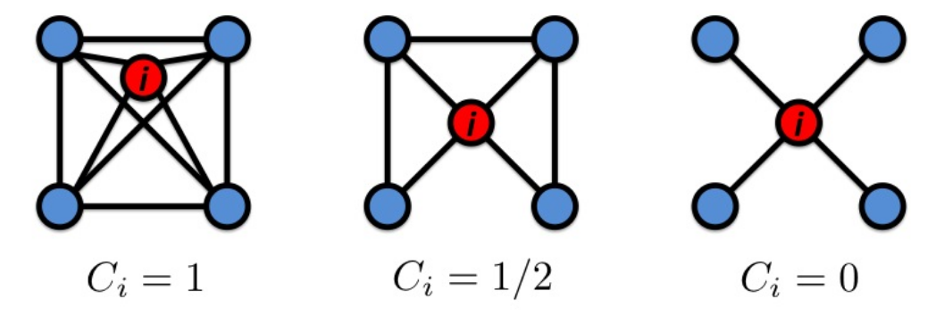
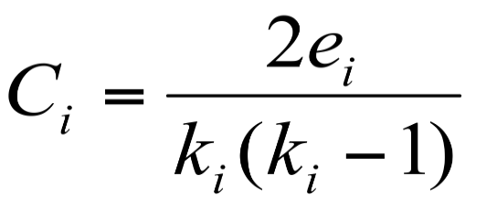
Node Level Features & Statistics
Node Degree : Quantify Node Connectivity
Clustering Coefficient : Measures the proportion of closed triangles in a node’s local neighborhood
COMPUTER
SCIENCE

Slide 8
Graph Level Features & Statistics
Bag Of Nodes : Aggregate node level statistics
Degree Distribution : Histogram of degrees of nodes
Size of largest connected component : Largest set where any 2 vertices are joined by a path
COMPUTER
SCIENCE
Notes:
https://towardsdatascience.com/feature-extraction-for-graphs-625f4c5fb8cd

Slide 9
Limitations of Feature based learning
Hand-Engineered features are not flexible
Require domain knowledge
Time consuming and expensive
Not Scalable
COMPUTER
SCIENCE
DATA
PROCESSING
Notes:
Solution: We will look to learn representations in the slides ahead instead of trying to extract these features on our own.

Slide 10
Transductive Learning
Data observed beforehand, both training & testing.
Make use of the patterns and additional information present in the unlabelled data during the learning process
It builds no predictive model.
Need to retrain the model again if an unknown node if added to the graph.

Slide 11
Inductive Learning
It is the same as what we commonly know as traditional supervised learning.
It builds a predictive model.
No need to retrain the learned model while predicting a new unknown node if added to the graph.

Slide 12
An Aside : Message Passing

Slide 13
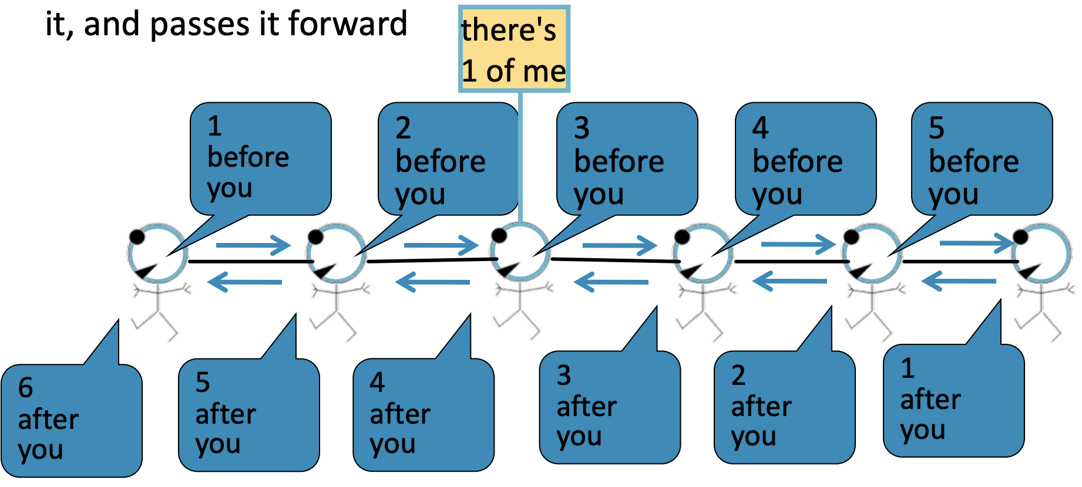
Basics
Task : Count the number of nodes in the graph
Condition : Each node only interacts with its neighbors
MATHEMATICS

Slide 14
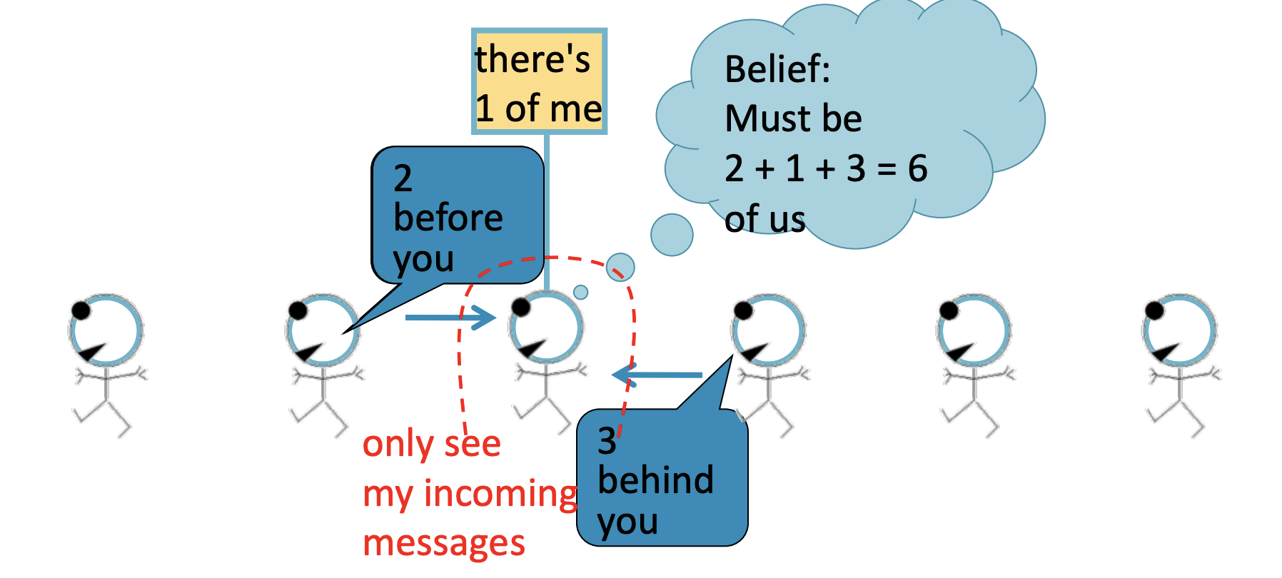
Local Picture
MATHEMATICS

Slide 15
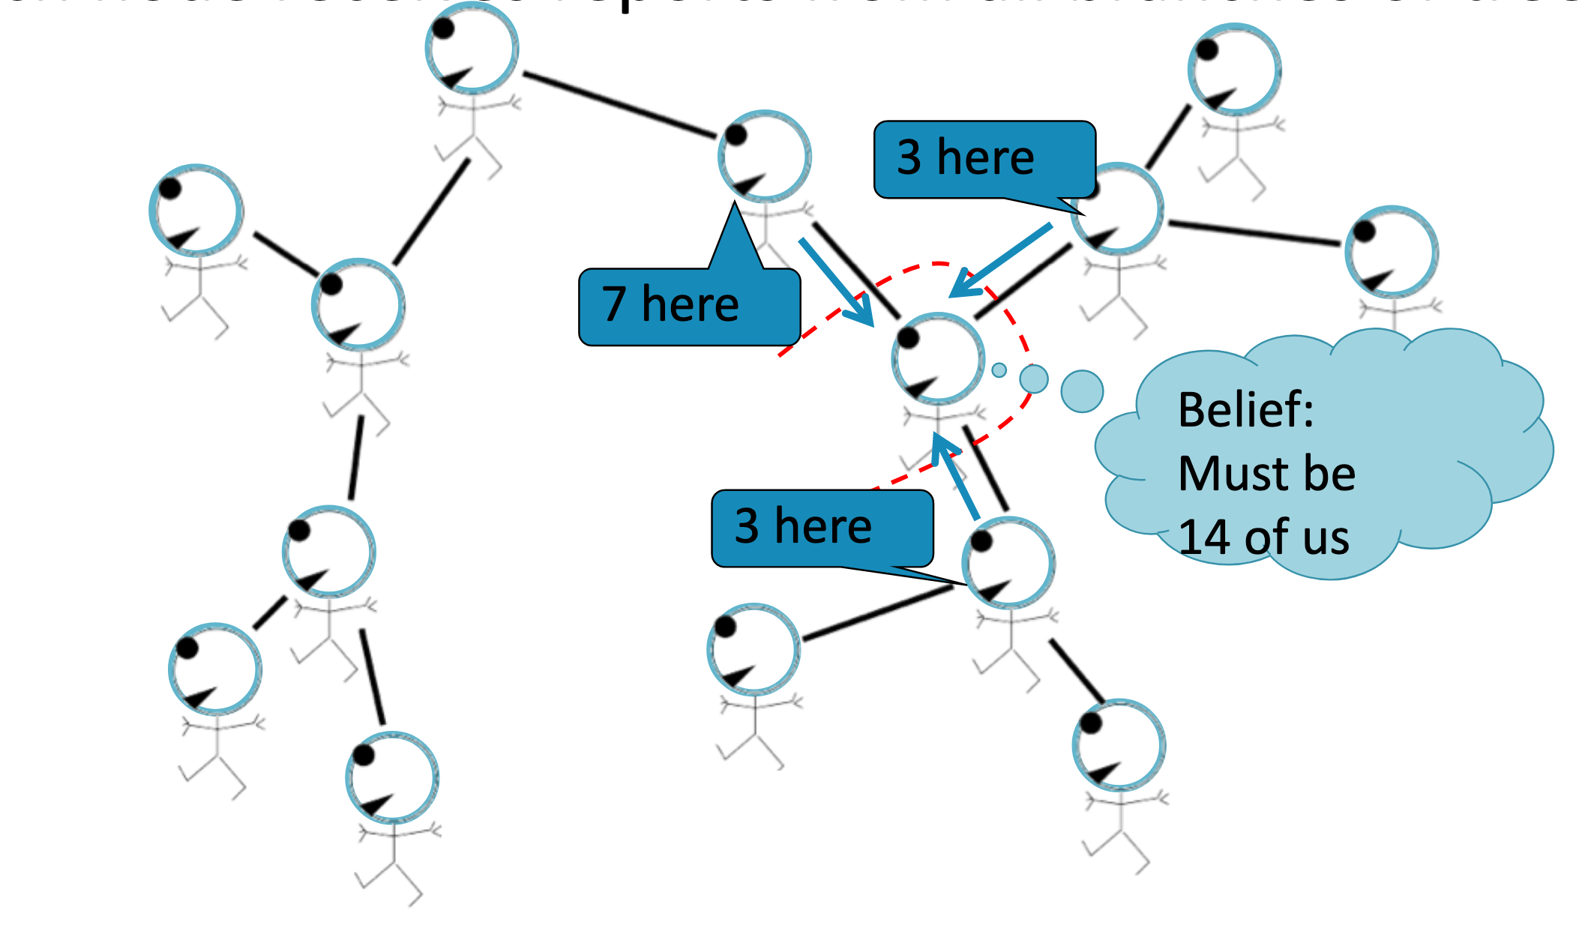
Graph Picture
MATHEMATICS

Slide 16
Towards
Learning Representations on Graphs

Slide 17
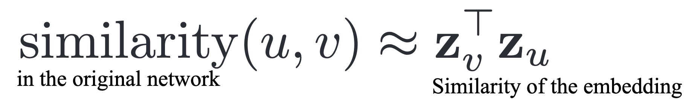


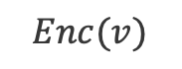
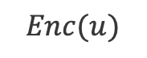
Shallow Embeddings
Encode Nodes as Low-Dimensional Vectors
Project nodes into a latent space
MATHEMATICS
$$Enc(u)$$
Geometric relations in this latent space correspond to relationships (e.g., edges)
$$z_{u}$$
Encode Nodes
$$z_{v}$$
$$Enc(v)$$
Embedding Space
Original Graph

Slide 18
Deep Walk
Random Walk based similarity
Mechanism to learn node vector representations
Uses ideas from language modeling

Slide 19
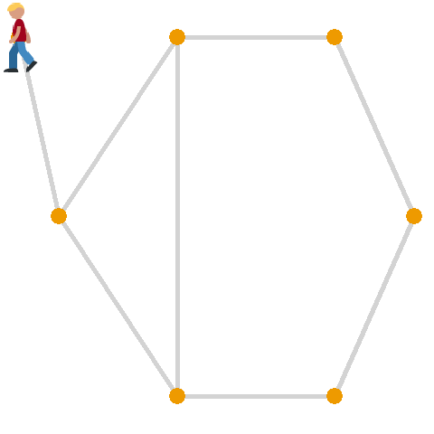
Deep Walk : Network Similarity with Random Walks
What is a random walk?
A stochastic process, that describes a path that consists of a succession of random steps to traverse the nodes on a graph.
Similarity of 2 nodes is just the probability of their co-occurrence in a random walk
MATHEMATICS
COMPUTER
SCIENCE
DATA
PROCESSING
DOMAIN
EXPERTISE

Slide 20
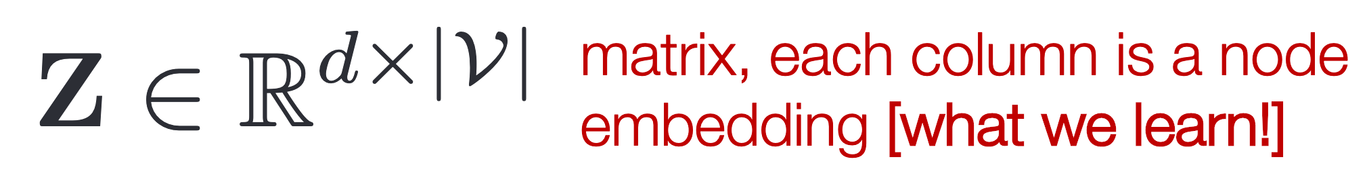
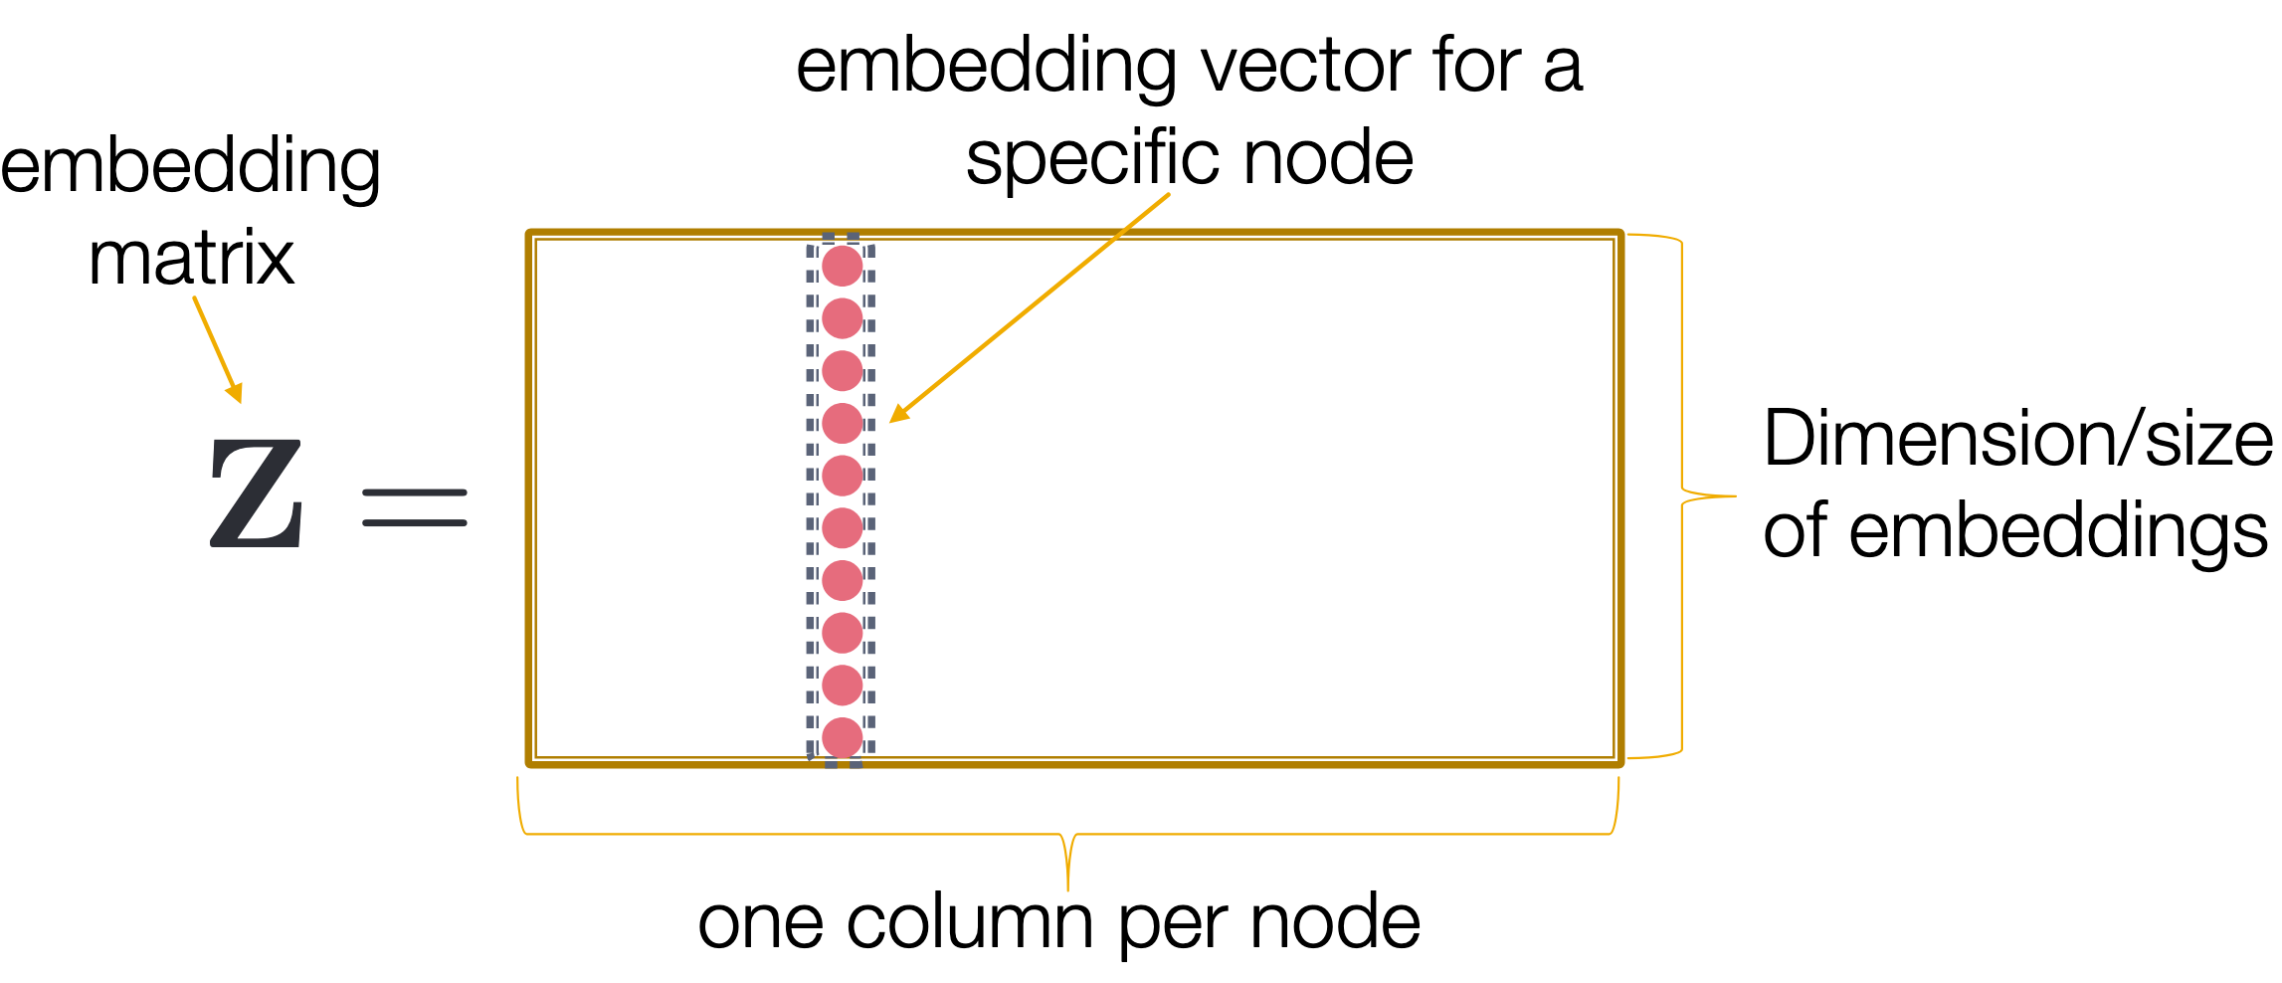
Deep Walk : Encoder
Encoder is an Embedding i.e. just a matrix lookup

Slide 21
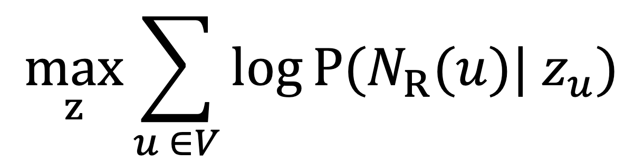
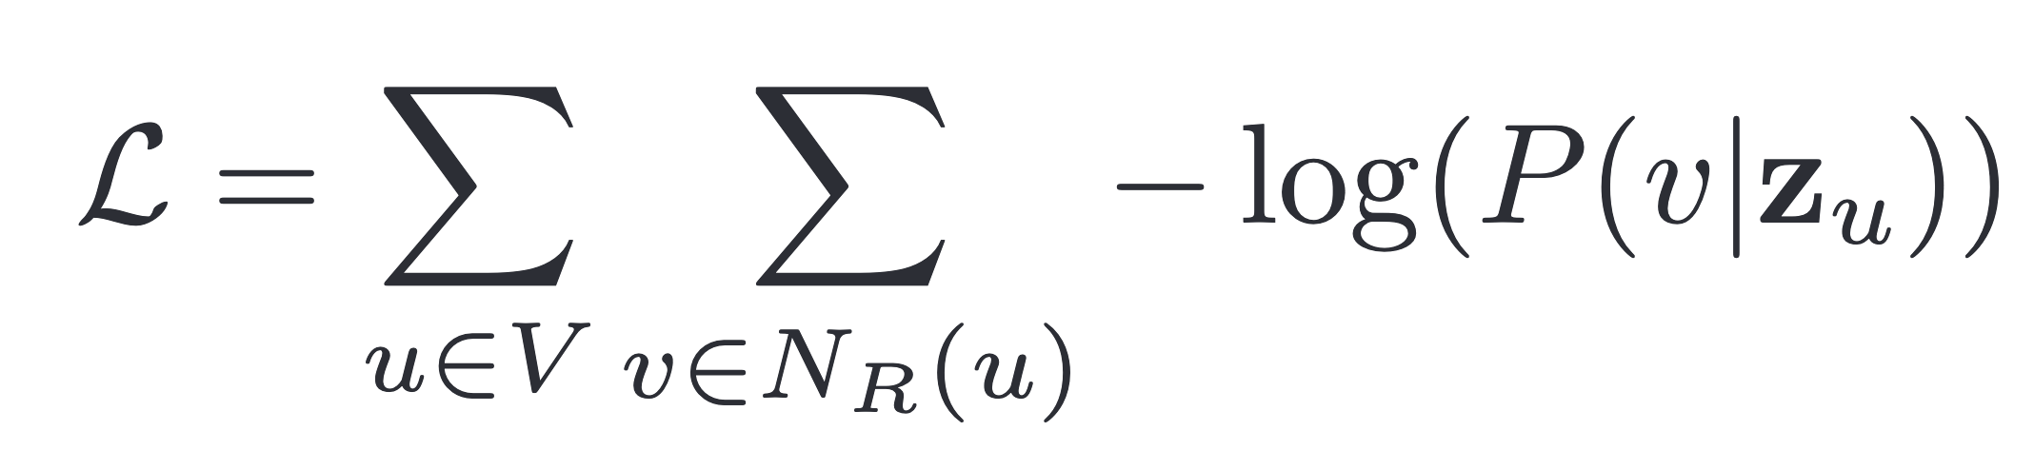
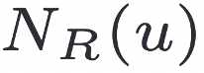
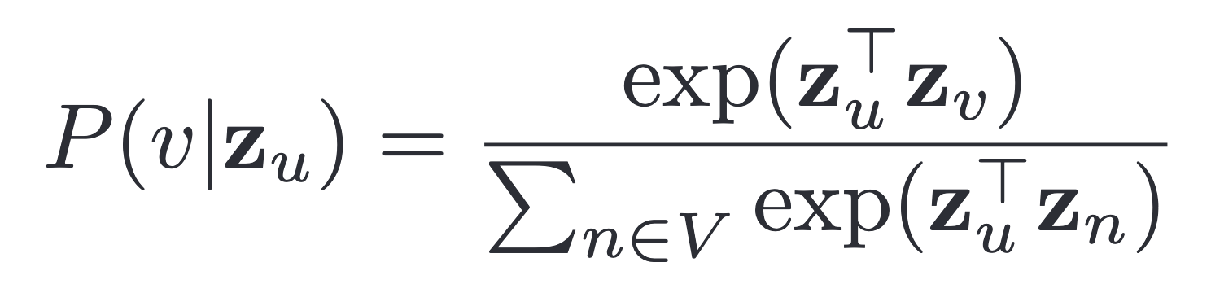
Deep Walk : Objective
Generate embeddings that optimize the similarity in the original network = likelihood of random walk co-occurrences
≣
: multiset of nodes visited on random walks

Slide 22
Analogy to word2vec
All Languages are sequences of words
Eg:
A random walk on a graph is analogous to a sentence and can be understood as a sequence of node occurrences.
Eg:

Slide 23
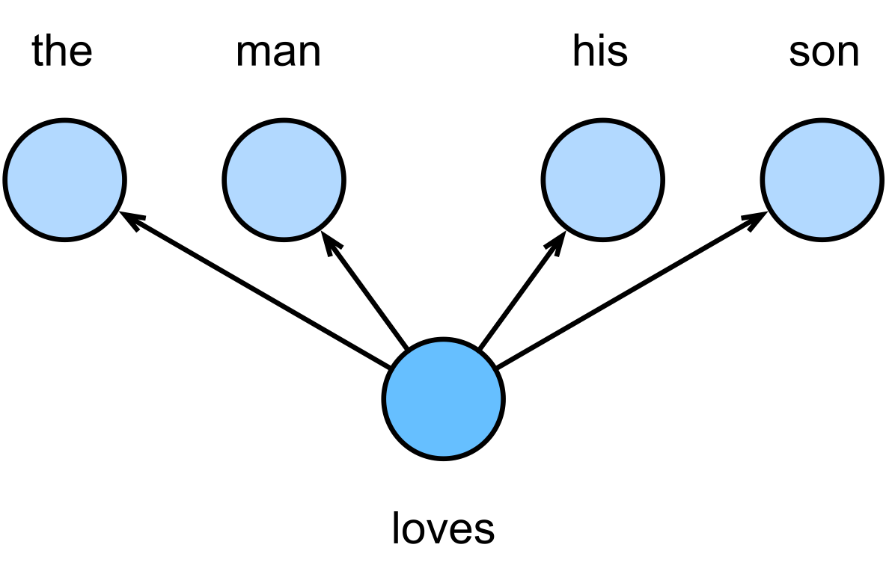
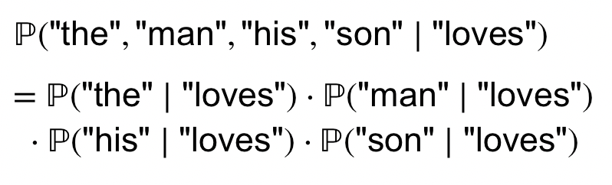
Word2vec - Skip-gram Model
Our assumptions:
A word can be used to generate the words that surround it.
Given the center word, the context words are generated independently.

Slide 24
Deep Walk
Create multiple random walk samples for a node u and collect N_{r}(u), the multiset of nodes visited on these random walks.
Optimize the loss function using backprop to update embedding matrix Z
The embeddings maximize the probability that closeby points in the embedding space correspond to nodes that are highly likely to co-occur in random walks
Use the learned embeddings as node representations.

Slide 25
Deep Walk
Learns meaningful representations for each node in the form of vector embeddings
These learnt representations can then be used in downstream tasks like node classification etc.
Leverage neighborhood information for extracting meaningful embeddings
MATHEMATICS

Slide 26
Limitations of Shallow Embeddings
Transductive
Does not leverage node features
No parameter sharing

Slide 27
Graph Neural Networks

Slide 28
Why is Deep Learning on Graphs hard?
Common Deep Learning architectures don’t work on graphs
Lack of defined grid structure
Variable Neighborhood
Isomorphism problem
Grid
Graph
Constant Neighbors
Fixed ordering of Neighbors
Variable Neighbors
No ordering of Neighbors

Slide 29
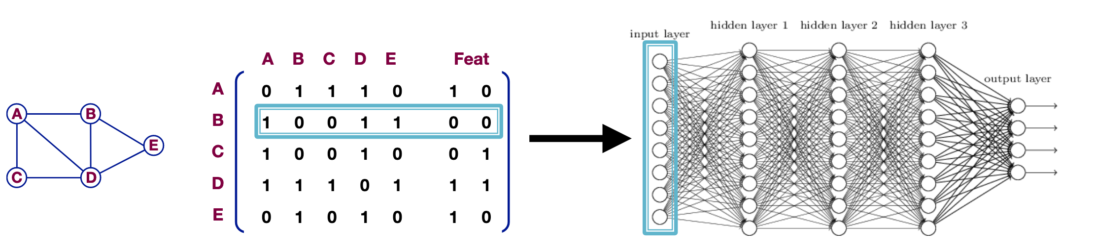
Why is Deep Learning on Graphs hard?
Can we use the Adj Matrix as input to a Neural Network?
Notes:
Permutation invariance and equivariance
One reasonable idea for defining a deep neural network over graphs would be to simply use the adjacency matrix as input to a deep neural network. For example, to generate an embedding of an entire graph we could simply flatten the adjacency matrix and feed the result to a multi-layer perceptron (MLP).
The issue with this approach is that it depends on the arbitrary order- ing of nodes that we used in the adjacency matrix. In other words, such a model is not permutation invariant, and a key desideratum for designing neural networks over graphs is that they should be permutation invariant (or equivariant)
Permutation invariance means that the function does not depend on the arbitrary ordering of the rows/columns in the adjacency matrix.

Slide 30
Why is Deep Learning on Graphs hard?
Can we use the Adj Matrix as input to a Neural Network?
No.
Not Permutation Invariant.
Number of neural net params far exceeds number of data points
Notes:
Permutation invariance and equivariance
One reasonable idea for defining a deep neural network over graphs would be to simply use the adjacency matrix as input to a deep neural network. For example, to generate an embedding of an entire graph we could simply flatten the adjacency matrix and feed the result to a multi-layer perceptron (MLP).
The issue with this approach is that it depends on the arbitrary order- ing of nodes that we used in the adjacency matrix. In other words, such a model is not permutation invariant, and a key desideratum for designing neural networks over graphs is that they should be permutation invariant (or equivariant)
Permutation invariance means that the function does not depend on the arbitrary ordering of the rows/columns in the adjacency matrix.

Slide 31
A better approach?
What if we can combine the ideas behind Message Passing & Deep Walk?
Message Passing can be used to share and aggregate information
Deep Walk Idea: Use induced structure of the graph to learn embeddings for each node
MATHEMATICS

Slide 32
Graph Neural Networks (GNNs)
Node’s neighborhood is used to define a computational graph and learn an embedding.
Thus, embeddings use both the structure of the graph and the features of the nodes and edges.
Embeddings are learned in an end-to-end fashion, thus, the predictions are a function of the target node’s ego-network (the subgraph of the node and its neighbors)

Slide 33
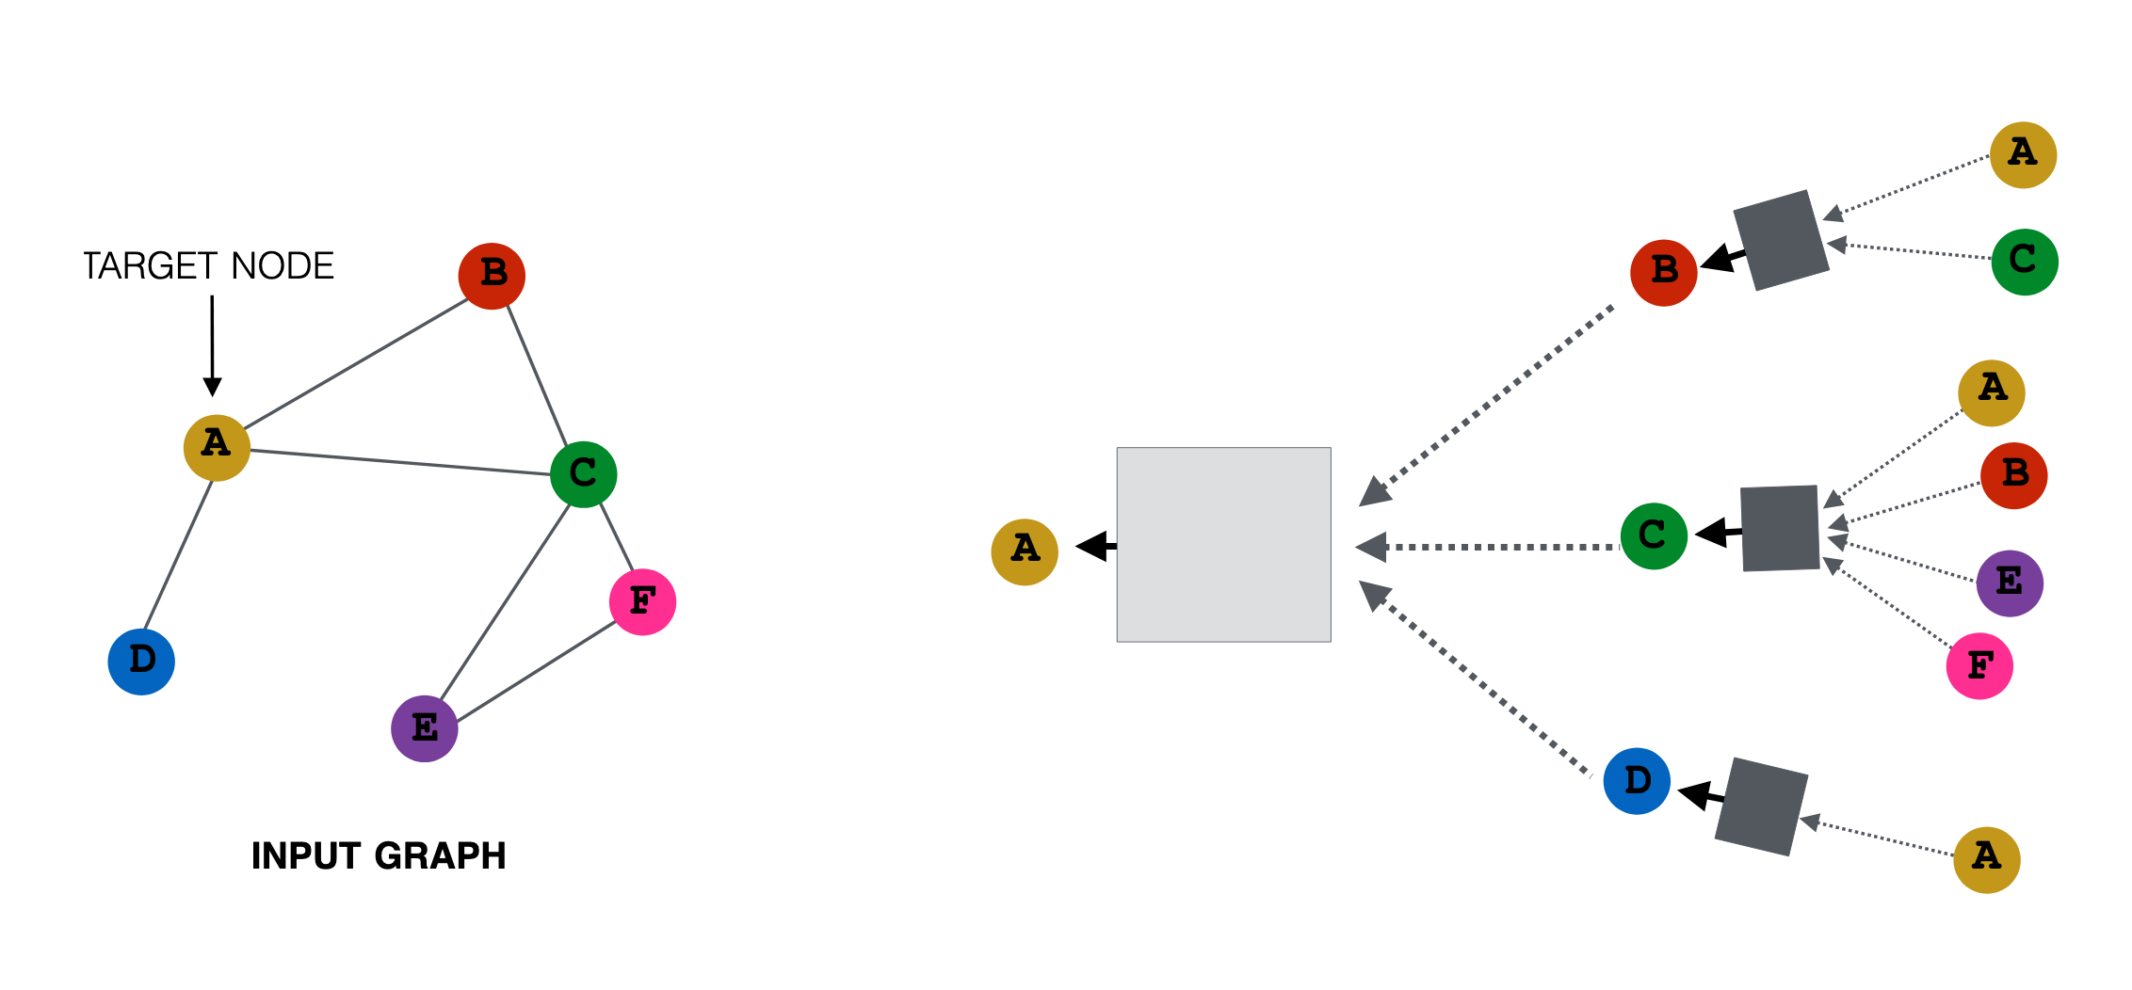
Graph Unrolling + Neighborhood Aggregation

Slide 34
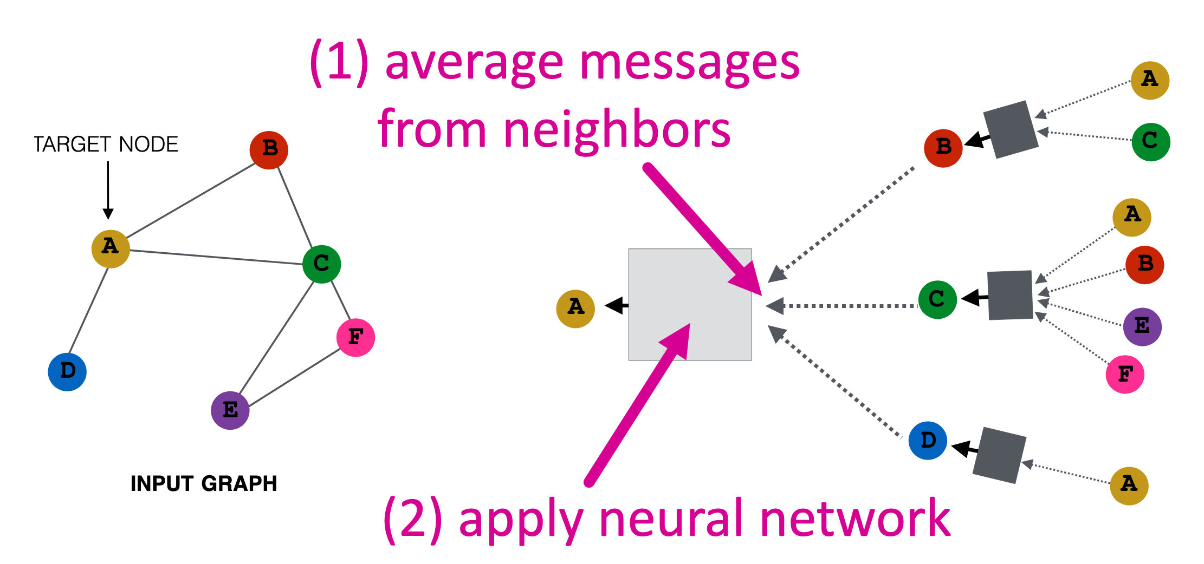
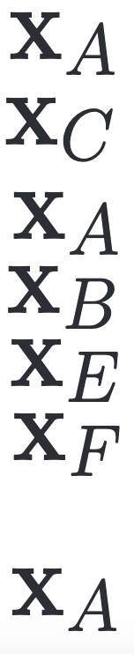
What’s in the box?
h_{B}
h_{C}
h_{D}

Slide 35
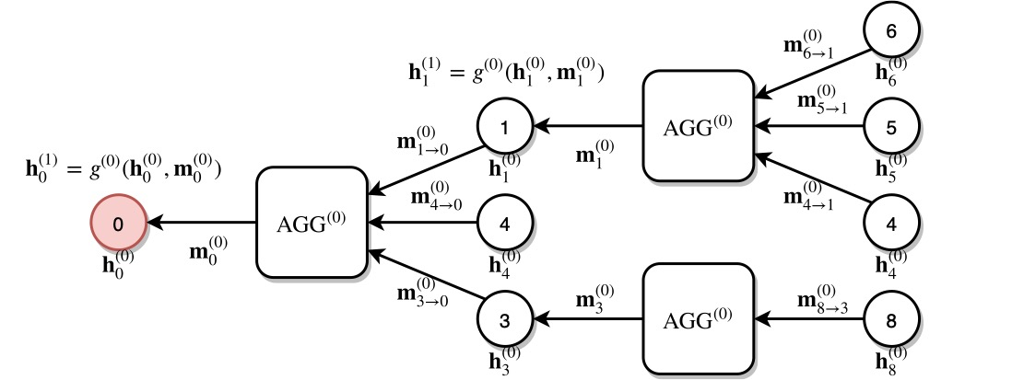
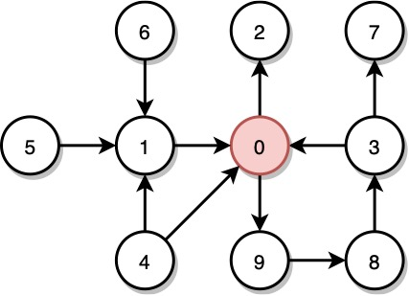
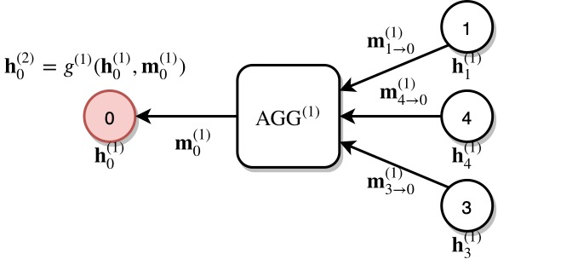
Why are GNNs better?
GNNs can integrate topologically distant information in a non-linear fashion.
1st layer
2nd layer

Slide 36
Why are GNNs better?
GNN models can be trained in an end-to-end fashion.
Traditional method
Classifier
GNN
Classifier
Notes:
There is no need to take out expensive time for computing node features. Everything is learnt end to end. We only need the target and the input graph for learning using GNNs.

Slide 37
Why are GNNs better?
Naturally inductive because they learn the same neural networks on all the nodes and edges.
GNN
GNN
Notes:
One interesting property of GNNs is that we can train our model on one subset of the graph and apply this model on another subset of this graph. The reason we can do this is that we can do parameter sharing, i.e. those processing boxes are the same everywhere (W and B are shared across all the computational graphs or architectures).
We know that our old methods like DeepWalk were not able to generalise to a new unseen graph. So if any new node gets added to the graph, we had to train our model from scratch, but since our GNNs generalise to the unseen graphs, so to predict the embeddings of the new node we have to make the computational graph of the new node, transfer the parameters to the unseen part of the graph and we can make predictions.

Slide 38
Inductive Prediction
A GNN was trained on original graph
New unlabeled node appears
k-hop neighborhood for the new node can be used to make prediction
?
If GNN has 2 hidden layers
If GNN has 1 hidden layers

Slide 39
Extending GNNs
Self Loops
Key shortcoming : New node features are not a function of its previous representation
The aggregated representation of a node is only a function of its neighbours and does not include its own features.
This may lead to the loss of the node identity and hence rendering the feature representations useless.
Easy Fix: Add self-loops.
Notes:
Later when we talk about graphsage we’ll also look at other methods of incorporating self node embedding using concatenation
This way, a node will become a neighbour of itself.

Slide 40
What’s in the new box?
+ B₁h_{B} ⁰
h_{B}
+ B₁h_{C} ⁰
h_{C}
h_{D}
+ B₁h_{D} ⁰

Slide 41
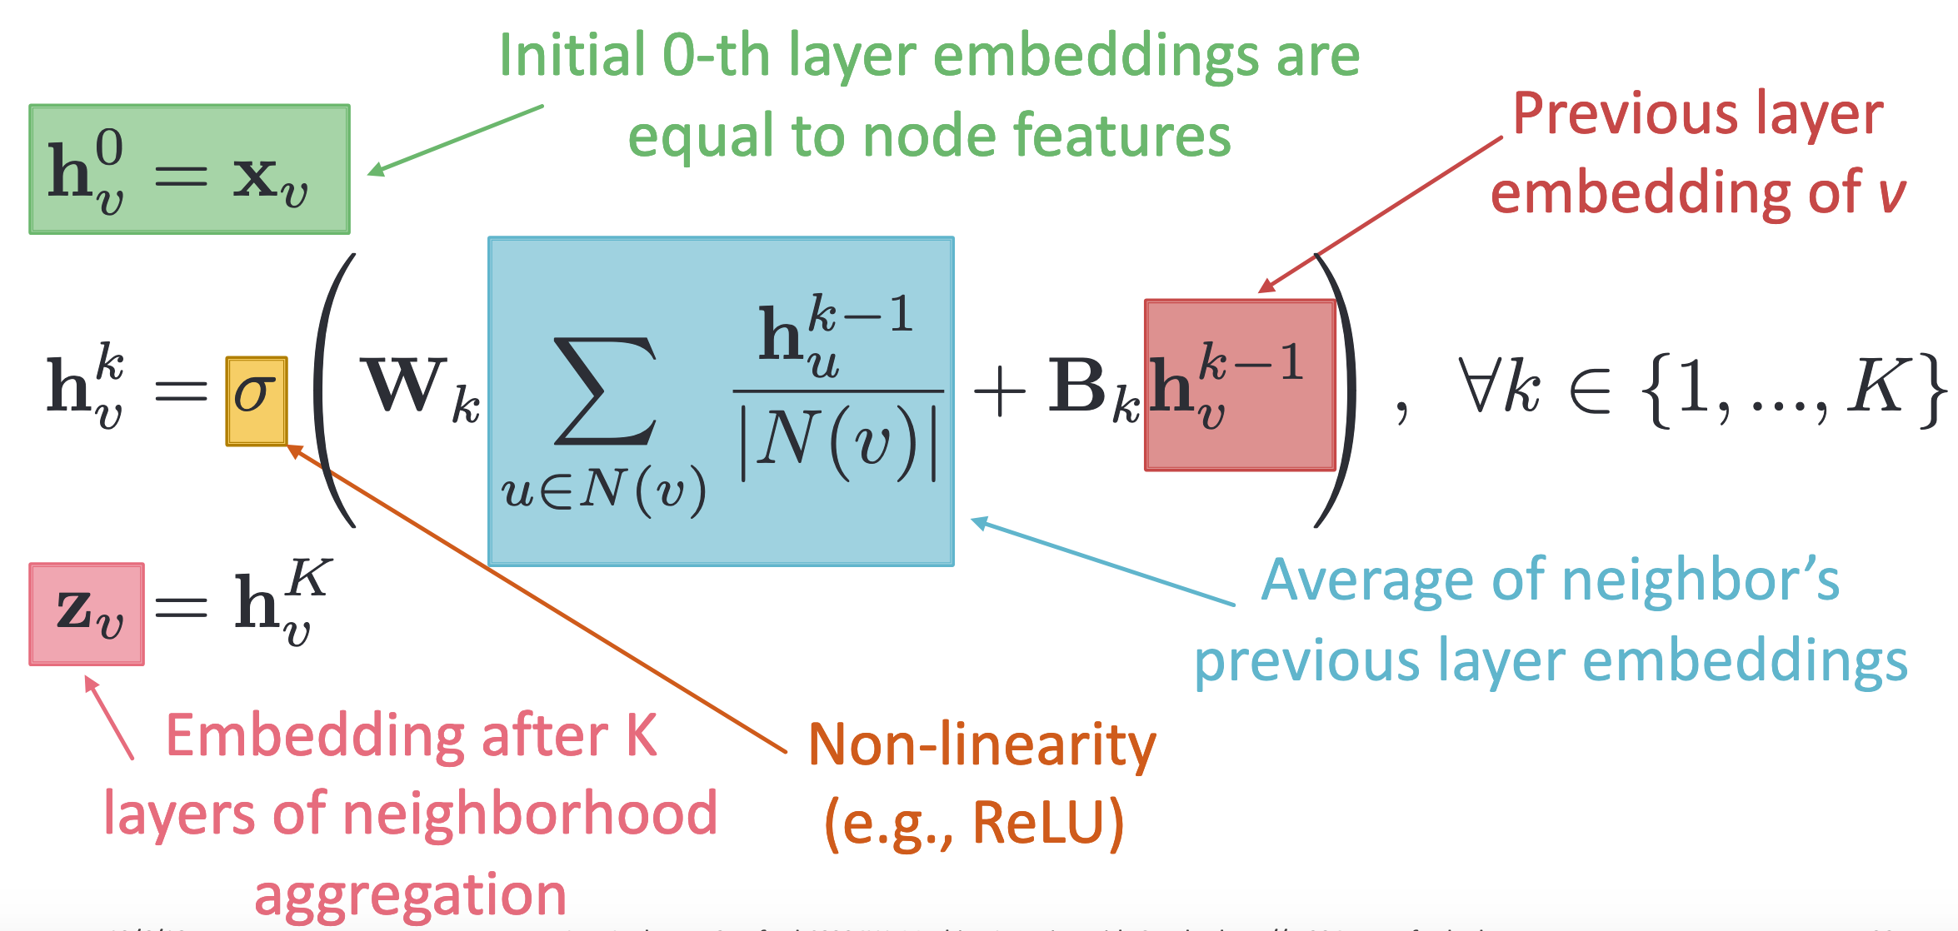
The Math

Slide 42
Learning with GNNs

Slide 43
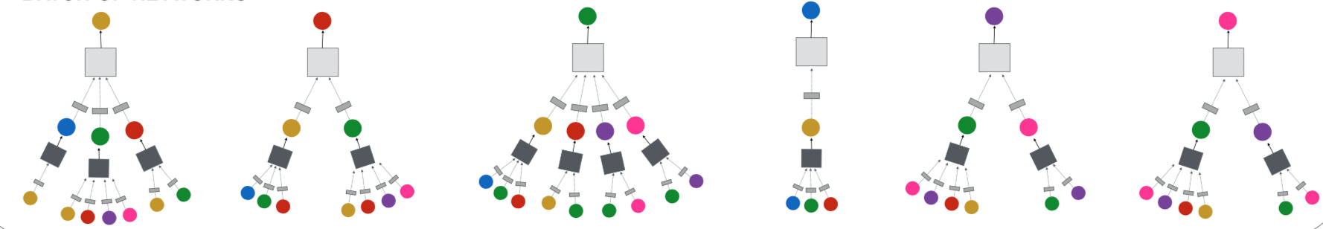
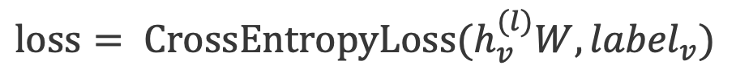
Node Classification Tasks
Node classification is trained in the semi-supervised setting.
$$loss= {CrossEntropyLoss(h}_{v}^{(l)}W, {label}_{v})$$
0
1
0
?
?
?

Slide 44
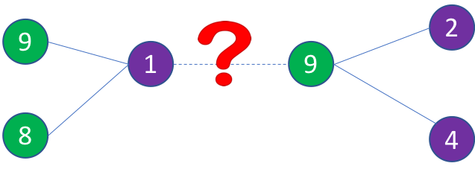
Link Prediction Tasks
We train a link prediction model with connectivity of nodes as the training signal.
Positive edges are trained against a few negative edges
${loss= −log (σ⁡(h}_{v}^{T}h_{w}))−Q∙E_{u_{n}\sim P_{n}(v)}{log (σ⁡(−h}_{v}^{T}h_{u_{n}})$)
Positive edges
Negative edges
Graph convolution to
encode node embeddings
Graph convolution to
encode node embeddings

Slide 45
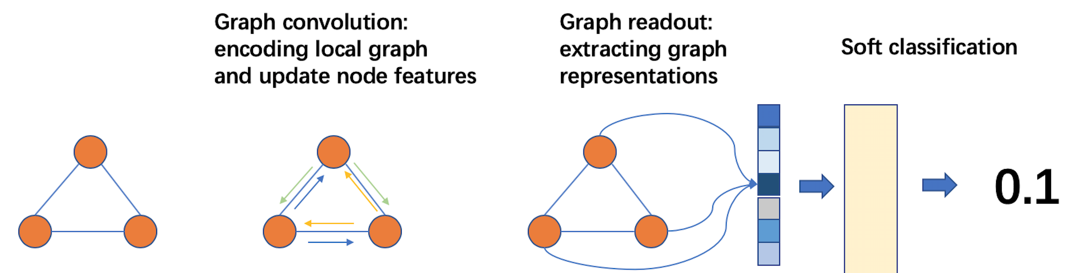
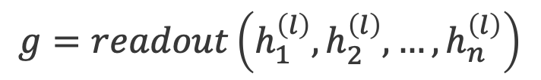
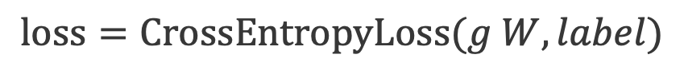
Graph Classification Tasks
$$g=readout\left(h_{1}^{\left(l\right)},h_{2}^{\left(l\right)}, …,h_{n}^{\left(l\right)}\right)$$
Graph readout to compute graph embeddings.
Train a graph classifier on the graph embedding.
$$loss=CrossEntropyLoss(g W, label)$$

Slide 46
Limitations of Graph Neural Networks
Oversmoothing : Loss of relevance of node features due to adding in neighbors’ features
Scalability
Notes:
over-smoothing:The essential idea of over-smoothing is that after several iterations of GNN message passing, the representations for all the nodes in the graph can become very similar to one another. This tendency is especially common in basic GNN models and models that employ the self- loop update approach. Over-smoothing is problematic because it makes it impossible to build deeper GNN models—which leverage longer-term dependencies in the graph—since these deep GNN models tend to just generate over-smoothed embeddings.

Slide 47

Walkthrough Notebooks

Slide 48
Deep Graph Library

Slide 49
DGL: The history
V0.43
TF support
DGL-KE/DGL-LifeScie
Sampling
V0.3.1
NN modules
DGL-Chem
Development started
V0.2
Sampling APIs
2018
2019
2020
V0.3
Fused message passing
Multi-GPU/-core
First prototype
V0.1
(NeurIPS’18)
V0.4
Heterogeneous graph
DGL-KE (preview)
V0.5
Distributed training

Slide 50
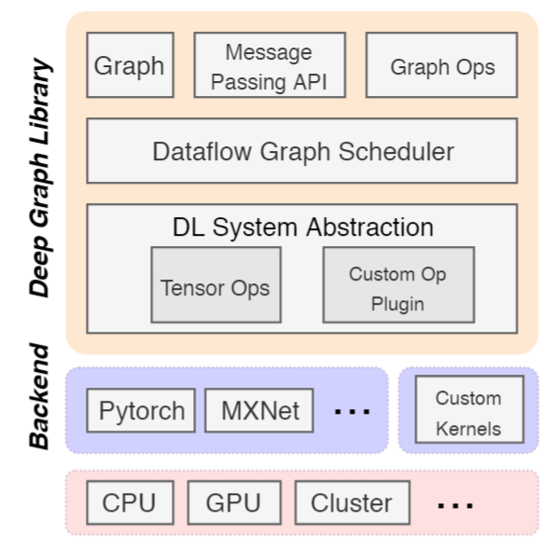
DGL meta-objectives & architecture
Forward and backward compatible
Forward: easy to develop new models
Backward: seamless integration with existing frameworks (MXNet/Pytorch/Tensorflow)
Fast and Scalable

Slide 51
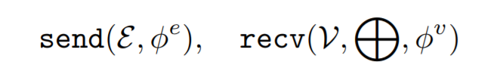
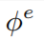
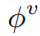
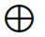
DGL programming interface
Graph as the core abstraction
DGLGraph
g.ndata[‘h’]
Simple but versatile message passing APIs
Active set specifies which nodes/edges to trigger the computation on.
can be user-defined functions (UDFs) or built-in symbolic functions.

Slide 52
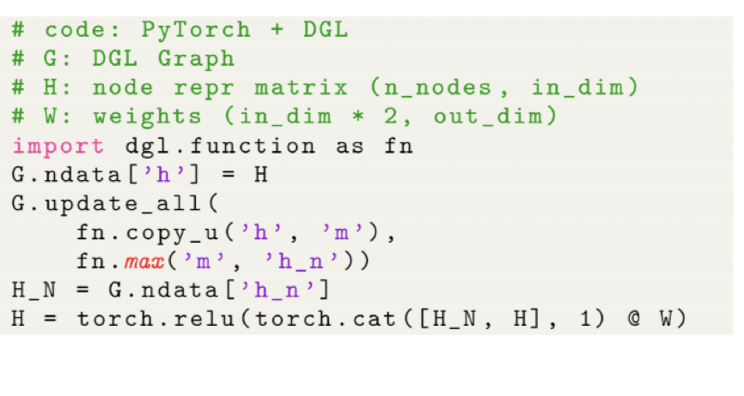
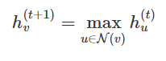
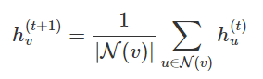
Writing GNNs is intuitive in DGL
update_all is a shortcut for send(G.edges()) + recv(G.nodes())

